Slide 1
Predicting Customer Churn
Classification Project

Slide 2
01
Introduction
Introduces the business need and goal of predicting customer churn.

Slide 3
Introduction
We start by loading our customer churn dataset. The goal: predict which customers are likely to leave, helping the business retain more clients.
https://github.com/hxmnxs

Slide 4
Introduction
import pandas as pd
df = pd.read_csv('churn.csv')
https://github.com/hxmnxs

Slide 5
02
Exploring the Data
Shows how the dataset is loaded and previewed for initial understanding.

Slide 6
Exploring the Data
We preview the first few rows to understand what information is available for each customer, such as contract type, tenure, and payment method.
https://github.com/hxmnxs

Slide 7
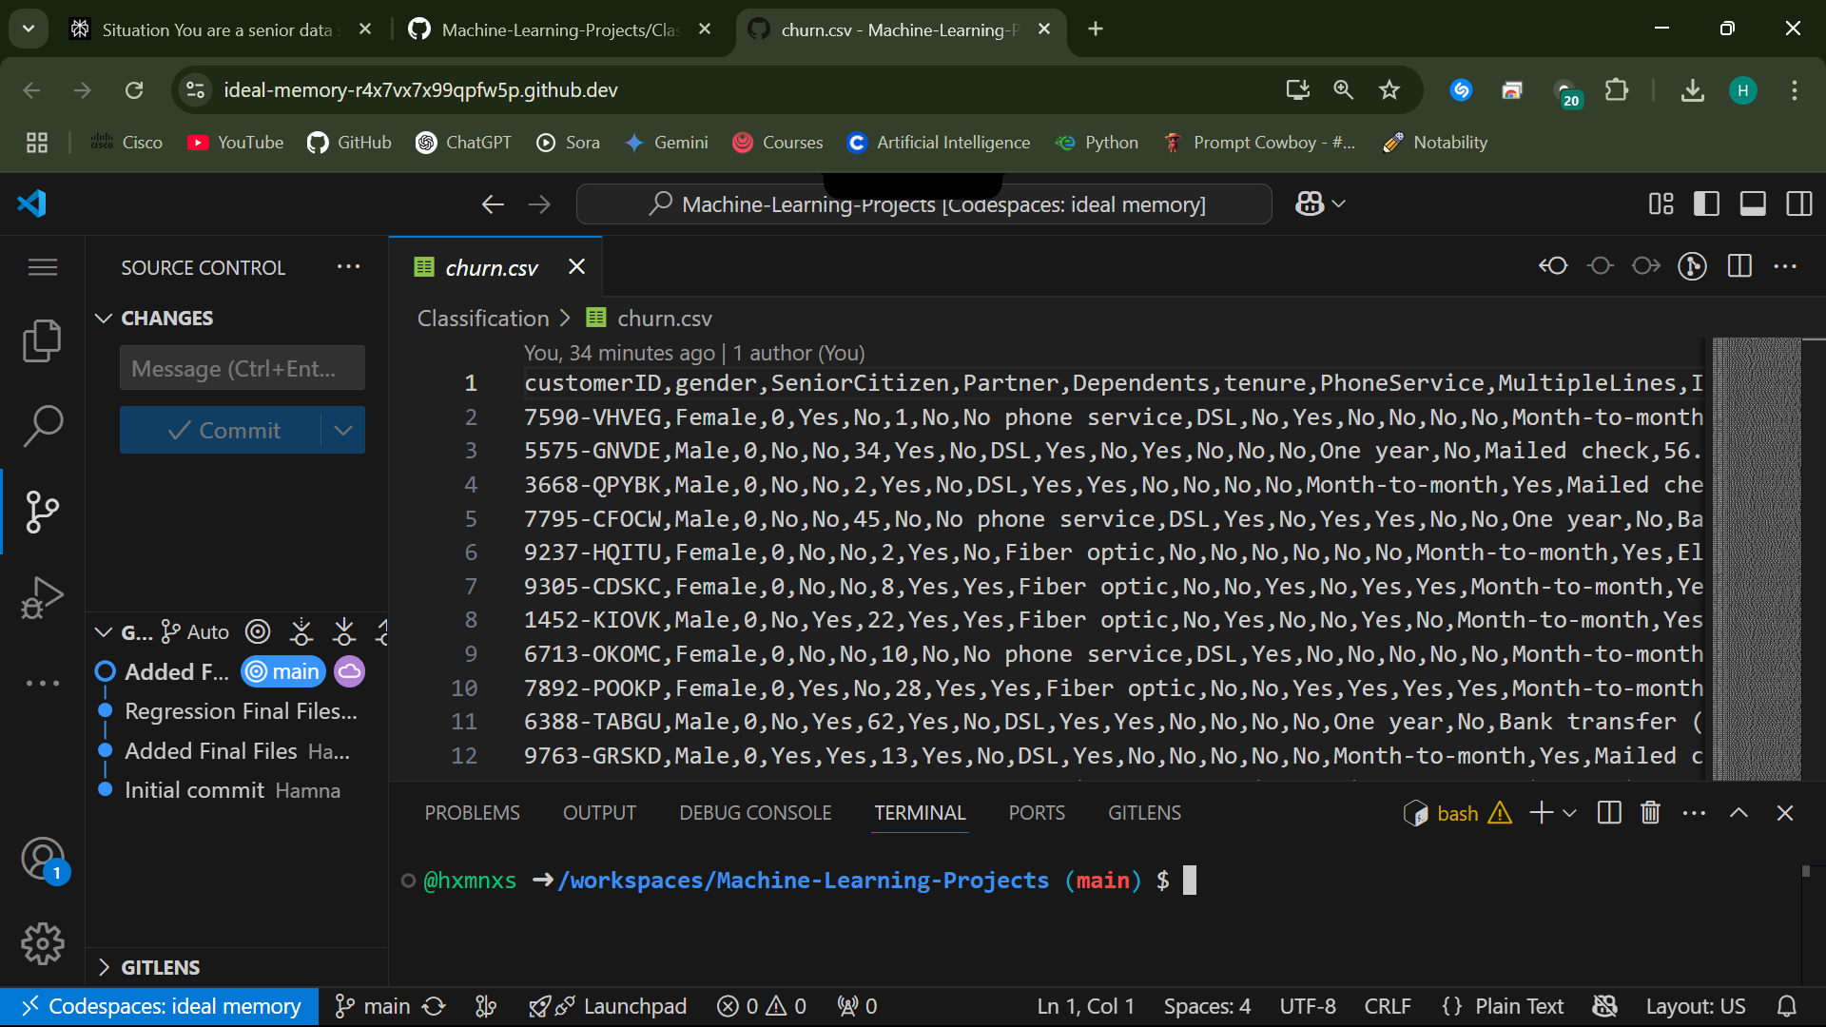
Exploring the Data
print(df.head())

Slide 8
03
Target Variable
Explains how the churn outcome is defined and its distribution checked.

Slide 9
Target Variable
We check how many customers have churned versus stayed. This helps us understand the balance of our prediction target.
https://github.com/hxmnxs

Slide 10
Target Variable
print(df['Churn'].value_counts())
https://github.com/hxmnxs

Slide 11
04
Key Features
Highlights important features that may influence customer churn.

Slide 12
Key Features
We focus on features that might influence churn, like how long a customer has stayed, their contract type, and their monthly charges.
https://github.com/hxmnxs

Slide 13
Key Features
features = ['tenure', 'Contract', 'MonthlyCharges']
print(df[features].describe())
https://github.com/hxmnxs

Slide 14
05
Data Cleaning
Scales and encodes data to prepare it for machine learning algorithms.

Slide 15
Data Cleaning
We remove or fix any problematic values (like empty spaces in ‘TotalCharges’) to ensure our data is ready for analysis.
https://github.com/hxmnxs

Slide 16
Data Cleaning
df = df[df['TotalCharges'] != ' ']
df['TotalCharges'] = df['TotalCharges'].astype(float)
https://github.com/hxmnxs

Slide 17
06
Encoding Categorical Data
Details the conversion of text categories into numerical values.

Slide 18
Encoding Categorical Data
We convert text categories (like contract types) into numbers, so machine learning models can use them.
https://github.com/hxmnxs

Slide 19
Encoding Categorical Data
df = pd.get_dummies(df, columns=['Contract', 'PaymentMethod'])
https://github.com/hxmnxs

Slide 20
07
Model Training
Outlines the process of training a machine learning model to predict churn.

Slide 21
Model Evaluation
We split the data into training and test sets, then train a logistic regression model to predict churn.
https://github.com/hxmnxs

Slide 22
Model Evaluation
from sklearn.model_selection import train_test_split
from sklearn.linear_model import LogisticRegression
X = df.drop(['Churn', 'customerID'], axis=1)
y = df['Churn'].map({'Yes':1, 'No':0})
X_train, X_test, y_train, y_test = train_test_split(X, y)
model = LogisticRegression()
model.fit(X_train, y_train)
https://github.com/hxmnxs

Slide 23
08
Model Evaluation
Summarizes how the model’s performance is measured and interpreted.

Slide 24
Predicting House Prices
We evaluate our model’s accuracy on unseen data to see how well it predicts churn.
https://github.com/hxmnxs

Slide 25
Predicting House Prices
print(model.score(X_test, y_test))
https://github.com/hxmnxs

Slide 26
Thanks!
Does anyone have any questions?
devhamnah@gmail.com
www.linkedin.com/in/devhamna
https://github.com/hxmnxs
The ultimate value of our analysis lies in actionable insights. By identifying at-risk customers and the factors driving churn, the business can tailor retention strategies, optimize offerings, and improve customer satisfaction.
This Presentation was created and designed By Humna Imran

